Slide 1
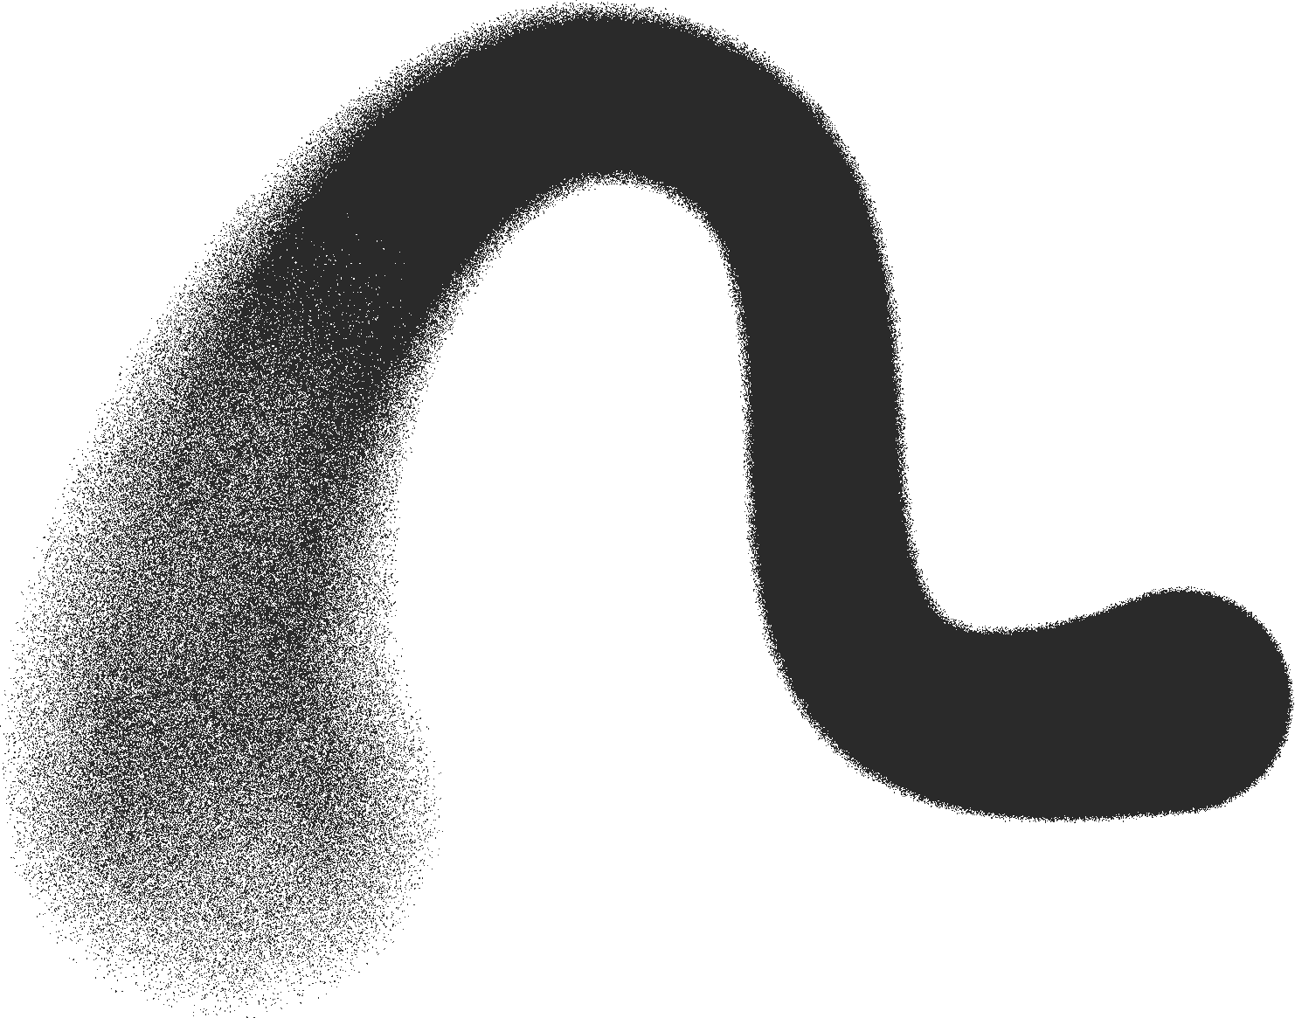



HEALTHCARE PROVIDER FRAUD DETECTION USING MACHINE LEARNING
CLAIMS, BENEFICIARIES, PROVIDER BEHAVIOR & PREDICTIVE MODELING
Brought to you by:
Karim Wafa
Abdelrahman Nazmy
Ammar Maged
Omar Darwish

Slide 2


Introduction
Problem
PROBLEM OVERVIEW
THE PROBLEM
Healthcare fraud costs millions annually
Fraudulent providers hide within large claim systems
Manual audits are slow, costly, and miss hidden fraud
Whats the goal?
Build a model that identifies high-risk providers before money is lost

Slide 3
Project Data & Sources
DATASETS USED
Inpatient Claims
Outpatient Claims
Beneficiary Information
Provider Labels (Fraud vs. Legitimate)
SCALE
558,211 claims
~5,000 providers
Fraud prevalence: ~10%

Slide 4


Data Integration Pipeline
KEY STEPS
Verified referential integrity (no missing keys)
Added ClaimType (Inpatient/Outpatient)
Merged all 4 datasets using Left Join on:
BeneID → Beneficiary
Provider → Fraud Label
Outcome
Complete “Master Claims” dataset
Zero loss of data

Slide 5

Data Quality & Missingness
THREE MISSINGNESS CATEGORIES
Imputation Strategy
Low (<2%)
Structural (~92%)
Sparse (>99%)
Financial → fill with 0.0
Physicians → "None" category
Codes → 0 (retain upcoding signals)
Dropped zero-variance columns

Slide 6


Logical Validity Checks
ENSURED NO IMPOSSIBLE CLAIMS:
Ghost Claims : Claim after death
Time Travel : Discharge before admission
Pre-Birth Claims : Claim before birth
Duration Validity : Claim ends before it starts
Result:
✔ 100% clean, logically consistent dataset

Slide 7


Multi-Level EDA Insights
Beneficiary Level
Mostly elderly; realistic Medicare demographics
Balanced gender
Chronic conditions are common
Provider Level
Huge variance in volume and reimbursement
Fraudulent providers behave differently than legitimate ones
Claim Level
Reimbursements highly right-skewed
Long-tail expensive claims
Outliers important for fraud signals

Slide 8

Fraud vs. Legitimate Behavior
We observed clear patterns:
Fraudulent Providers tend to have:
CONFIRMED THE DATASET HAS STRONG FRAUD SIGNAL
Higher claim counts
Higher total reimbursements
Different admission rates
Different average claim amounts

Slide 9

Provider-Level Aggregation
EACH PROVIDER BECOMES ONE ROW WITH FEATURES LIKE:
Total claims
Unique beneficiaries
Total/Avg reimbursement
Avg claim duration
Inpatient vs outpatient mix
Chronic condition prevalence
Admission behavior
Produces provider_level_dataset.csv used for modeling :
Fraudulent providers
Legitimate providers

Slide 10
Handling Class Imbalance
Fraud = only 10% → strong imbalance.
OUR STRATEGY: SMOTE
Generates synthetic minority samples
Improves Recall (catch more fraud)
Trade-off (acceptable):
Higher recall → lower precision
(better to audit more than miss fraud)
/4

Slide 11

Algorithm Selection
We evaluated five algorithms against the project's core constraints:
Interpretability: Crucial for explaining audit triggers to investigators.
Computational Feasibility: Must scale to thousands of providers.
Robustness to Imbalance: Must detect the ~10% fraud minority without bias.
Suitability for Mixed Data: Must handle financial (continuous) and flag (categorical) data.

Slide 12
Table of comaprison
Algorithm
Mixed Data
Imbalance
Interpretability
Logistic Regression
Low(Needs Scaling)
Low(Biased)
High (Coefficients)
SVM
Low (Needs Scaling)
Low
Low(Black Box)
Decision Trees
High
Low(Overfits)
High(Rules)
Gradient Boosting
Very High
Low(Complex)
High
Random Forest
High
High
Medium (Feat. Imp.)
Based on a theoretical assessment of healthcare fraud characteristics, we hypothesized that Random Forest would serve as the optimal primary model for this pipeline

Slide 13
Model Comparison Results
Model | Precision | Recall | F1-Score | ROC-AUC | PR-AUC
Logistic Regression | 0.465 | 0.851 | 0.601 | 0.957 | 0.757
Random Forest | 0.483 | 0.723 | 0.579 | 0.946 | 0.709
Decision Tree | 0.389 | 0.733 | 0.509 | 0.826 | 0.481
Gradient Boosting | 0.458 | 0.712 | 0.558 | 0.928 | 0.661
According to these results of this comparison the hypothesis rejected and logistic regression is chosen as our best model.

Slide 14
Model Comparison Results
Champion Model: Logistic Regression
Evaluated on 1,082 unseen providers.
Metric | Score | Interpretation
Recall (Sensitivity) | 85.15% | Primary KPI. Successfully identified 86 out of 101 fraudulent providers.
Precision | 46.49% | For every 100 flagged providers, ~46 are truly fraudulent. Acceptable trade-off to maximize Recall.
ROC-AUC | 0.9569 | Excellent ability to rank fraudulent providers higher than legitimate ones.
F1-Score | 0.6014 | Strong balance between Precision and Recall for an imbalanced dataset.

Slide 15

Why Logistic Regression Won
HOW IS LOGESTIC REGRESSION BEST?
/1
/2
/3
Highest Detection Ability
Perfect fit for engineered features
Compliance & Explainability
Found 86 out of 101 fraudulent providers
Best balance between false positives & false negatives
Each coefficient explains risk direction
Supports legal & audit processes
Aggregation made fraud risk almost linear

Slide 16
Model Evaluation
STABILITY & OVERFITTING CHECK:
/1
/2
Cross-Validation (5-fold)
Overfitting Check
Recall: 0.8099 ± 0.04
ROC-AUC: 0.9327 ± 0.01
Training Recall: 80%
Test Recall: 85%

Slide 17
Business Impact
WITHOUT MODEL:
Using a standardized cost model:
Missed fraud = $10.1M loss
WITH OUR MODEL:
Audit cost: $185K
Remaining fraud loss: $1.5M
Total cost = $1.68M
NET SAVING:
$8.4 Million saved (83% reduction)

Slide 18
Error Analysis
ERROR ANALYSIS
/1
False Positives (Legitimate flagged)
False Negatives (Fraud missed)
/2
Micro-Fraudster: Very low total billing (~$20k); no strong financial signal.
Average Thief: Metrics match global averages; used upcoding to stay hidden.
Moderate Biller: High average cost but very low volume, which canceled the risk signal.
Likely Hospital: $1.3M revenue, 90% inpatient share; large legitimate provider.
High-Volume Clinic: 792 claims; multi-doctor clinic mistaken as “churning.”
Expensive Specialist: High reimbursement + inpatient activity; flagged due to cost magnitude, not fraud.

Slide 19
Improvments
FUTURE IMPROVEMENTS
Peer-group segmentation
Add unsupervised anomaly detection
Graph network analysis for collusion detection
Ratio-based financial features

Slide 20
CONCLUSION
WHAT WE ACHIEVED:
BUILT A FULLY INTEGRATED ML PIPELINE
ENGINEERED HIGH-QUALITY FEATURES
SELECTED A HIGHLY INTERPRETABLE MODEL
ACHIEVED 85% FRAUD DETECTION
DEMONSTRATED $8.4M COST SAVINGS
PROVIDED CLEAR NEXT STEPS FOR SCALING

Slide 21



Presentation
THANK YOU
WE’RE HAPPY TO ANSWER ANY QUESTIONS
DONE BY:
KARIM WAFA
ABDELRAHMAN NAZMY
AMMAR MAGED
OMAR DARWISH

